Slide 1
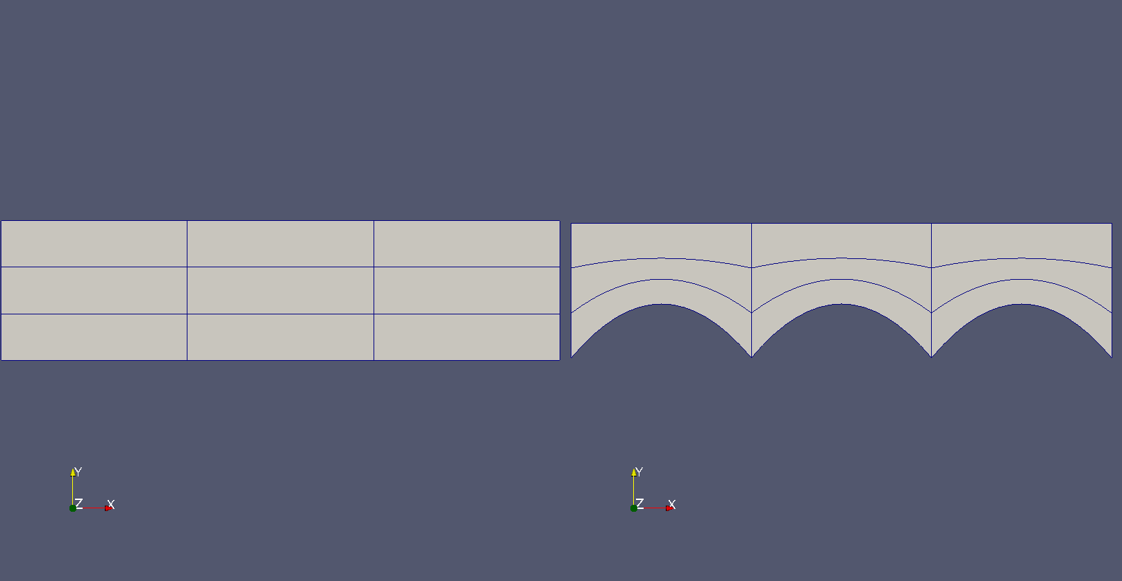
Curved Mesh Generation using Radial Basis Function
Quadrilateral Mesh

Slide 2
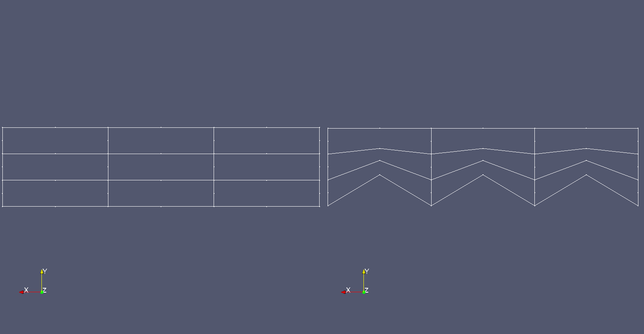
Same quadrilateral mesh, but without quadratic visualization,
showing nodes

Slide 3
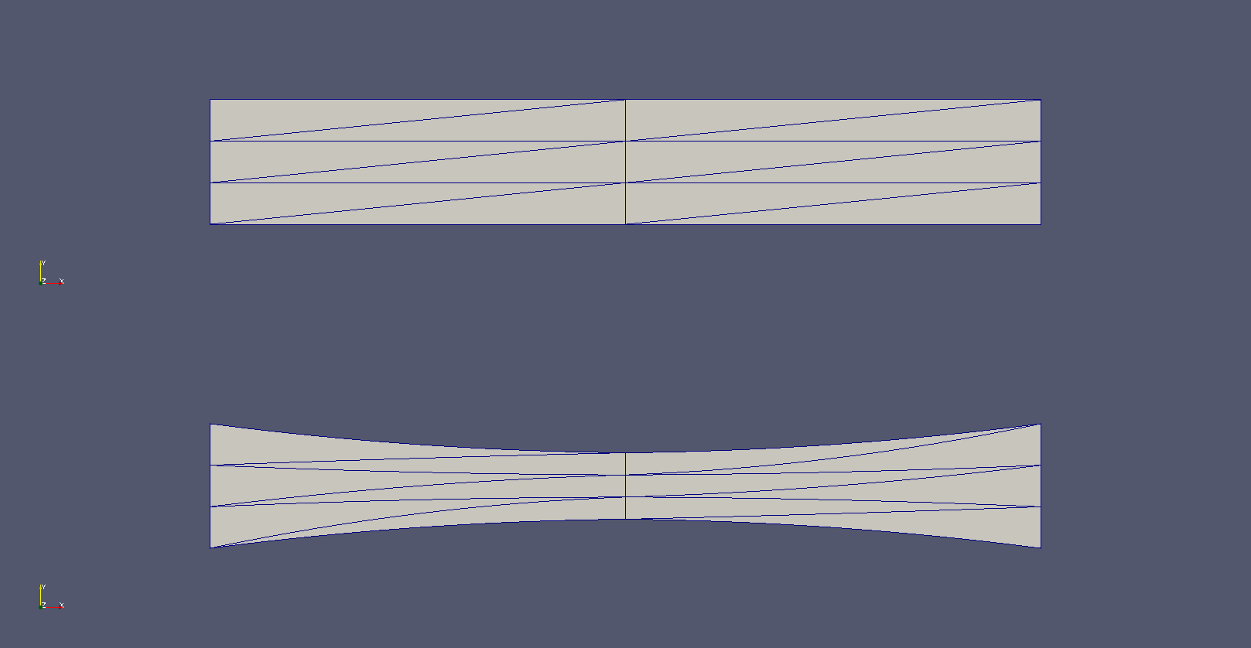
Triangular Mesh

